Slide 1

Modern Control Theory
Lecture No. 8
Review of Controllability & Observability
Concept of Stability

Slide 2

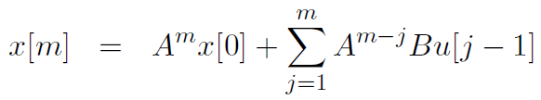

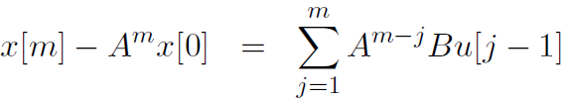
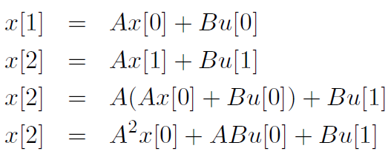

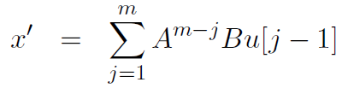
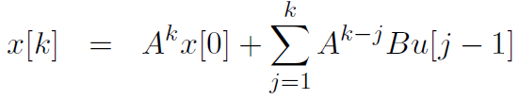
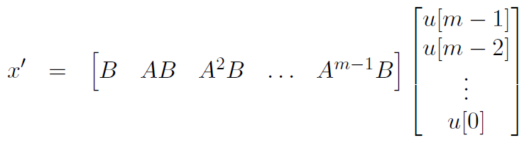
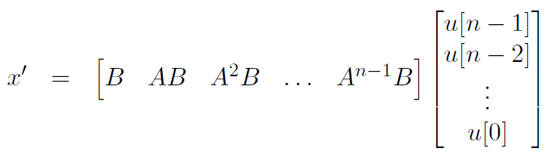
Concept of Controllability

Slide 3
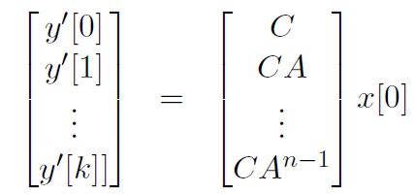

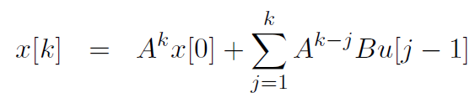
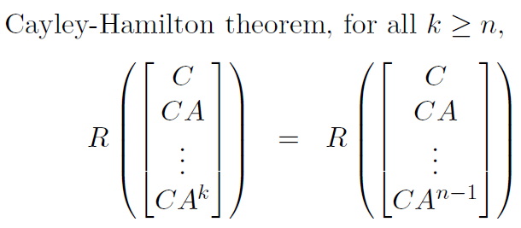
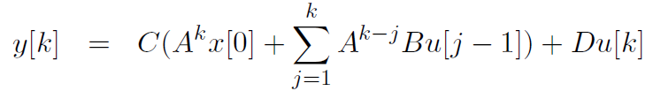
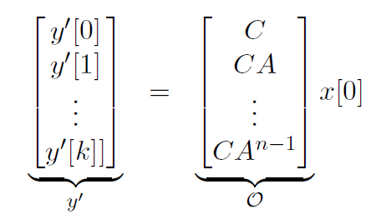
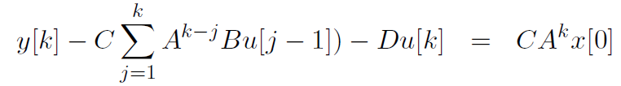

Concept of Observability in Discrete Domain

Slide 4
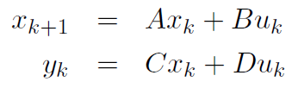


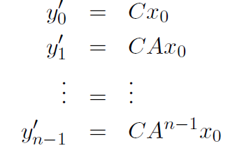

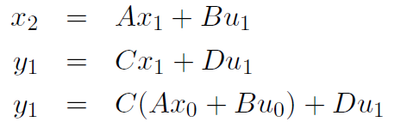
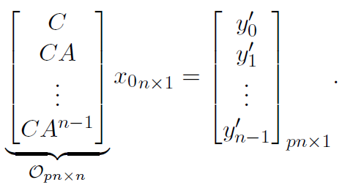


Slide 5

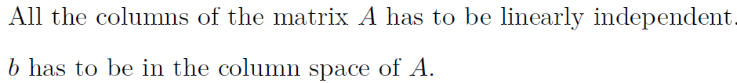
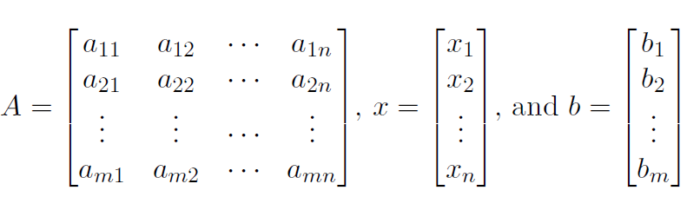


Controllability
Observability
Cols. of A --- Span the Complete Space of R
Matrix A has m l.i. Columns
All Rows of A are l.i. since No. of l.i Cols. = No. of l.i. Rows
Condn. on A to have at least one soln. for every vector b E R, is that A should be of full row rank
Cols.
All Vectors in A should be l.i. Full Rank, Square

Slide 6
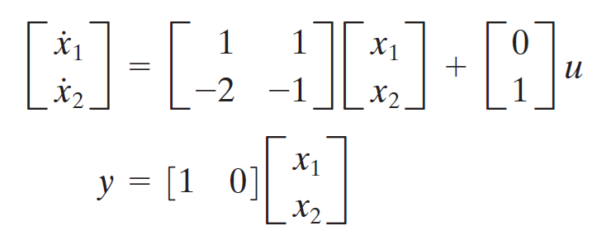
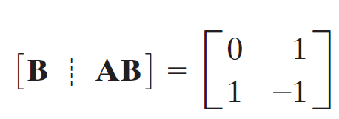
Check for Controllability & Observability

Slide 7

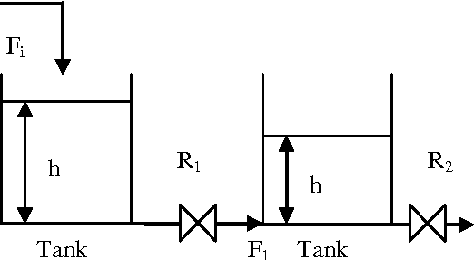


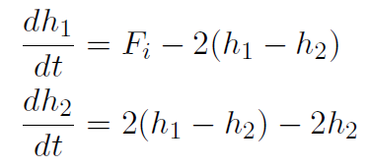
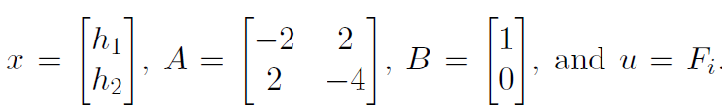
Check for Controllability

Slide 8
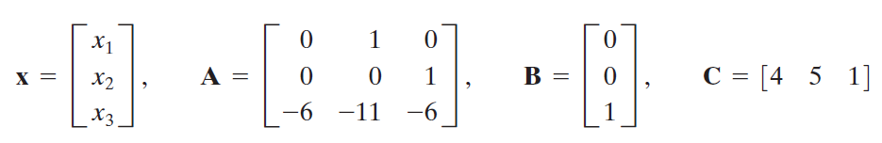
Check for Controllability & Observability

Slide 9
Controllability
Observability
Cols. of A --- Span the Complete Space of R
Matrix A has m l.i. Columns
All Rows of A are l.i. since No. of l.i Cols. = No. of l.i. Rows
Condn. on A to have at least one soln. for every vector b E R, is that A should be of full row rank
Cols.
All Vectors in A should be l.i. Full Rank, Square

Slide 10
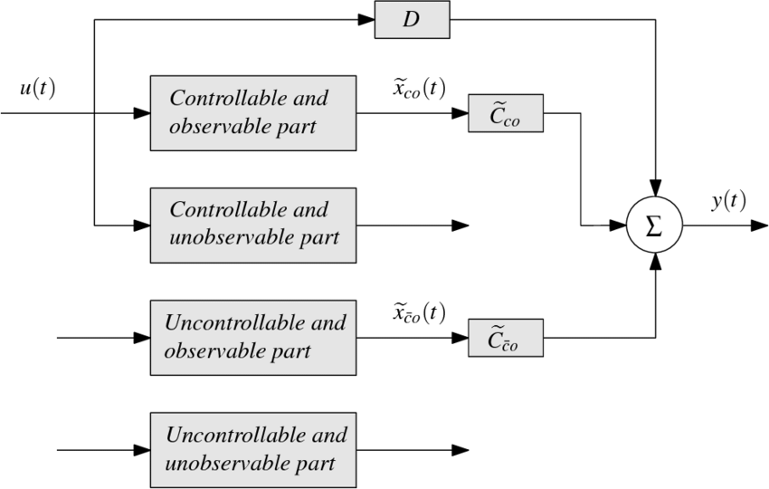
Uncontrollable & Unobservable Systems

Slide 11
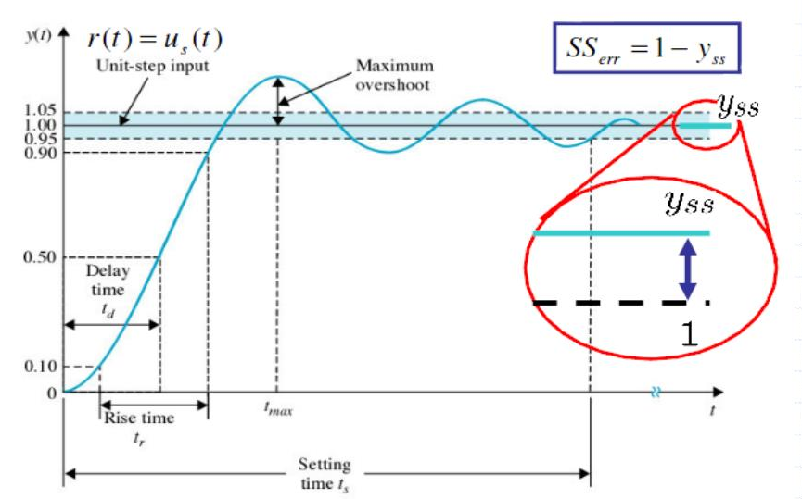
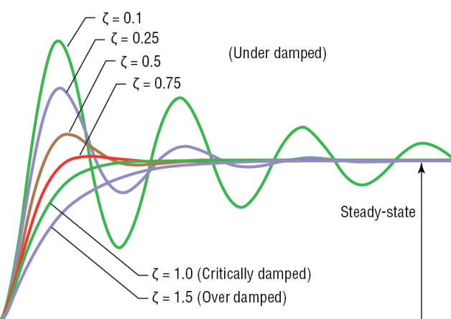
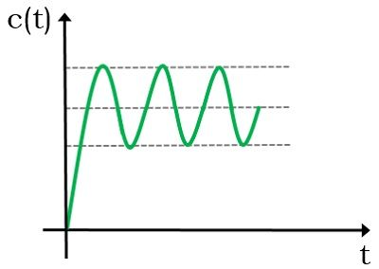
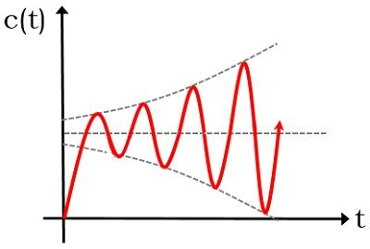
Stability in the Classical Control Concept

Slide 12






Stability Concepts
Marginal Stability
Absolute Stability
Asymptotic Stability
Lyapunov Stability
BIBO Stability
States are Bounded for most of the Inputs
There exists at-least one input, for which states are unbounded

Slide 13
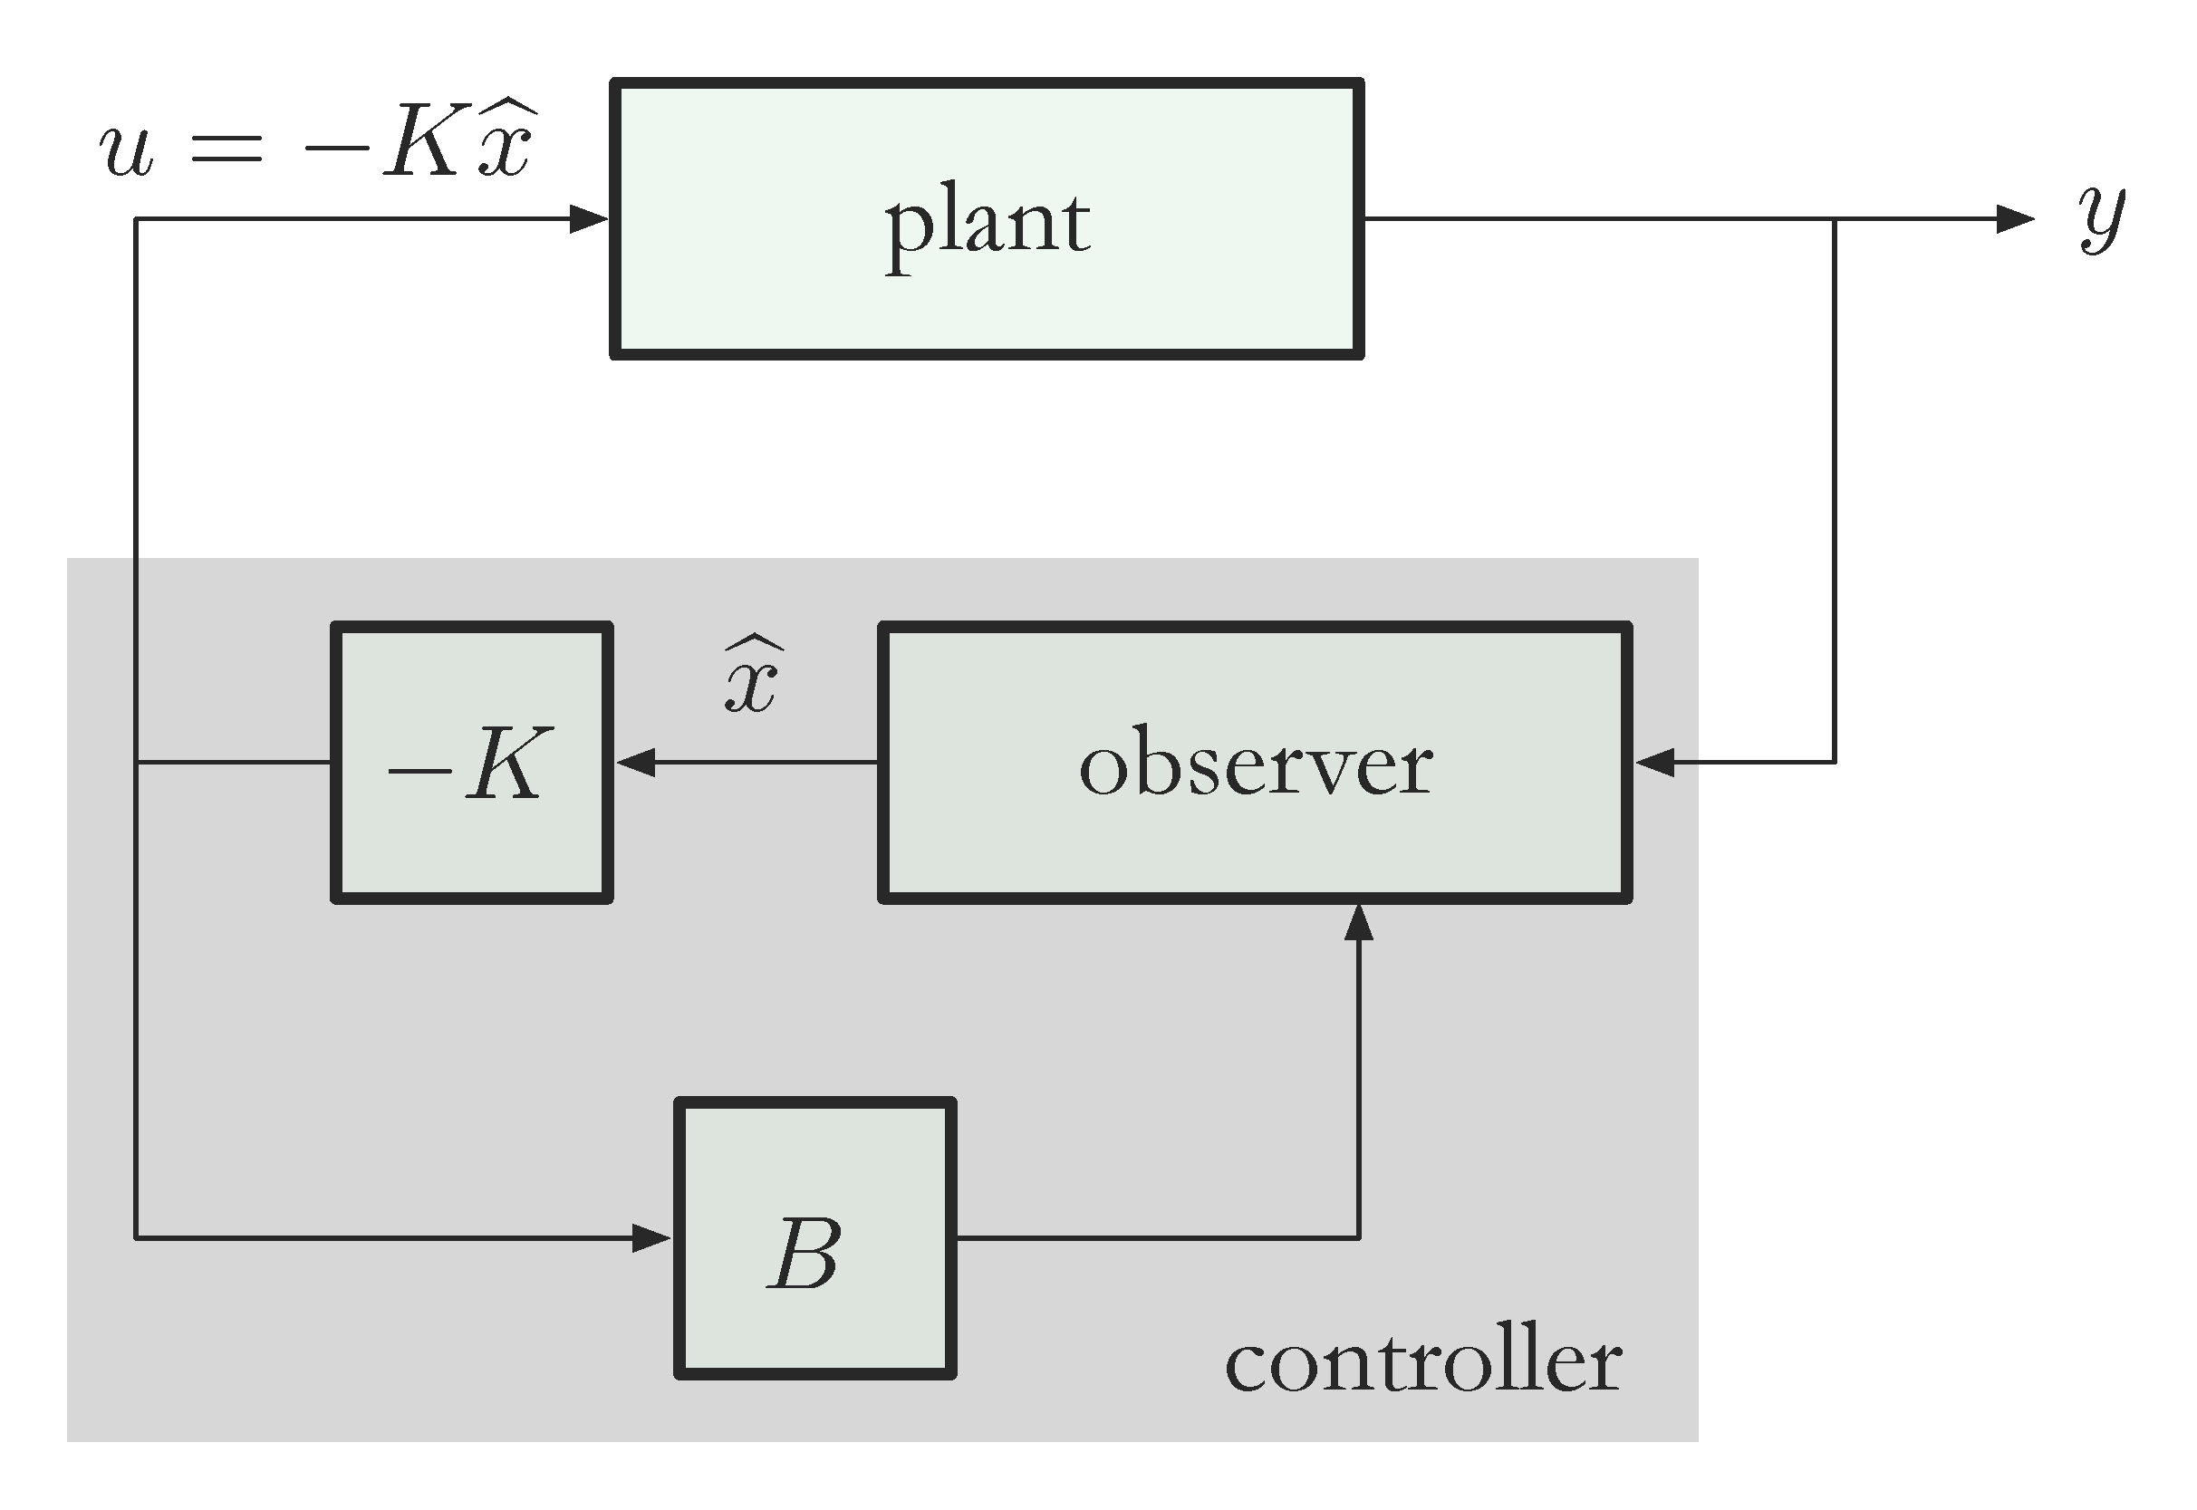


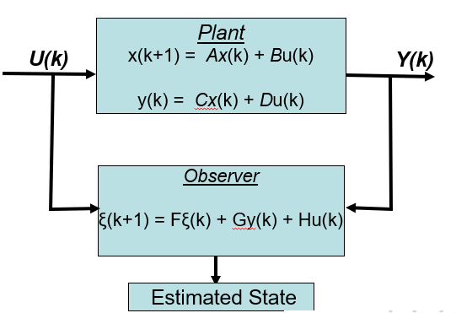
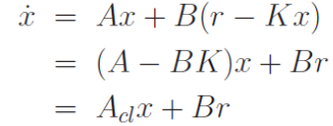
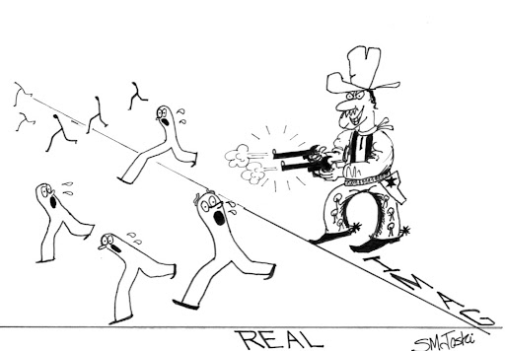
Controllability & Observability --- An Overview
State Space
X(k)
Observation Space /
Measurement Space
Input Space
X(0)

